Slide 1
2020 : a very special year documented by IASI
Cathy Clerbaux (1), Maya George (1), Anne Boynard (1,2), Sarah Safieddine (1), Juliette Hadji-Lazaro (1), Camille Viatte (1), Gaëlle Katchourine (1), Daniel Hurtmans (3), Pierre Coheur (3)
(1) LATMOS/IPSL, CNRS2), (2) SPASCIA, Ramonville-Saint-Agne, Toulouse, (3) Université libre de Bruxelles (ULB)
Cathy.clerbaux@latmos.ipsl.fr

Slide 2
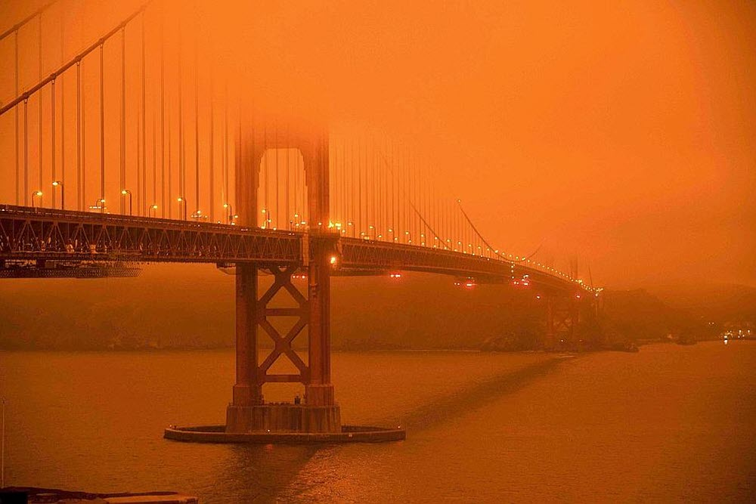
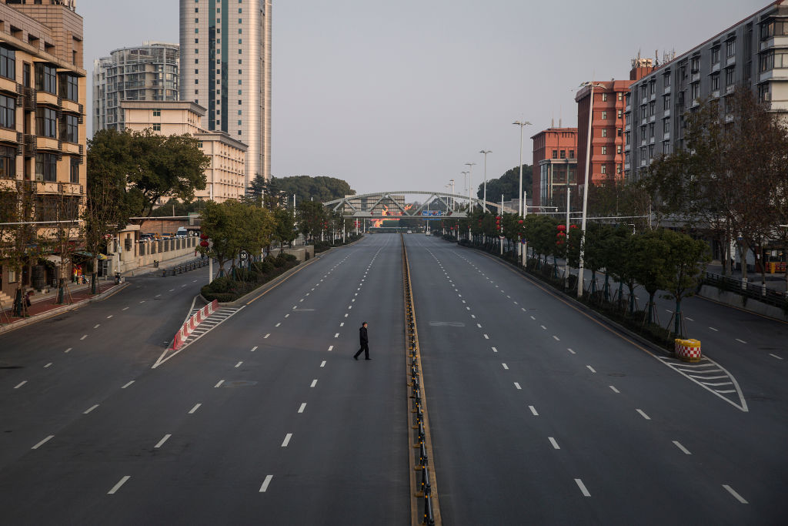
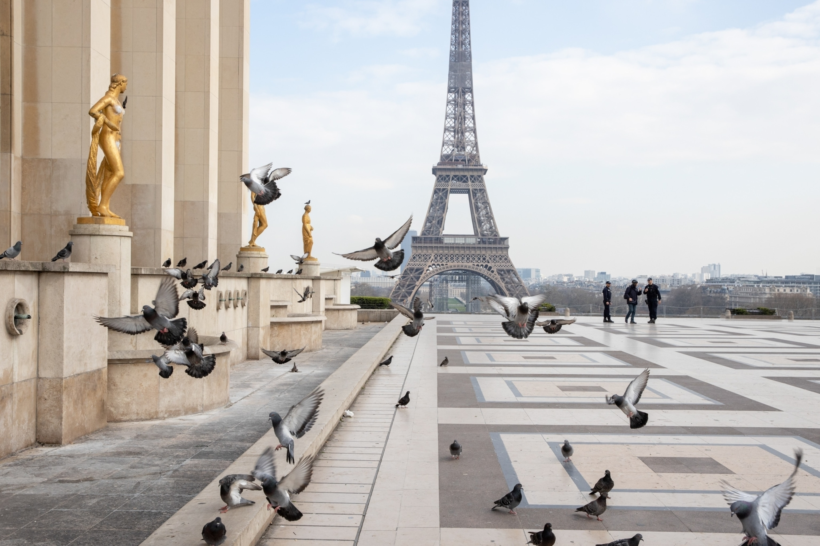
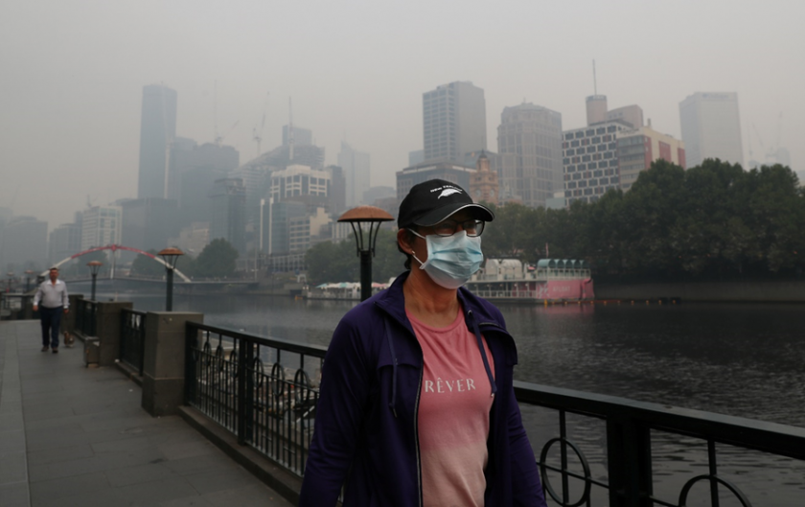

Slide 3
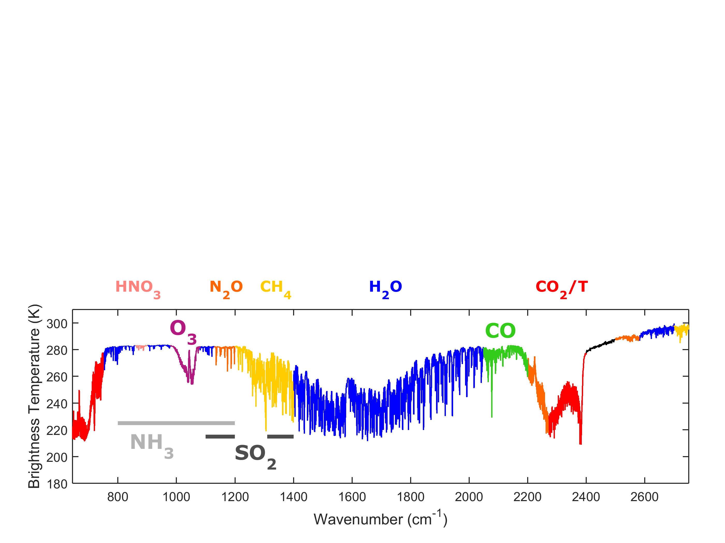




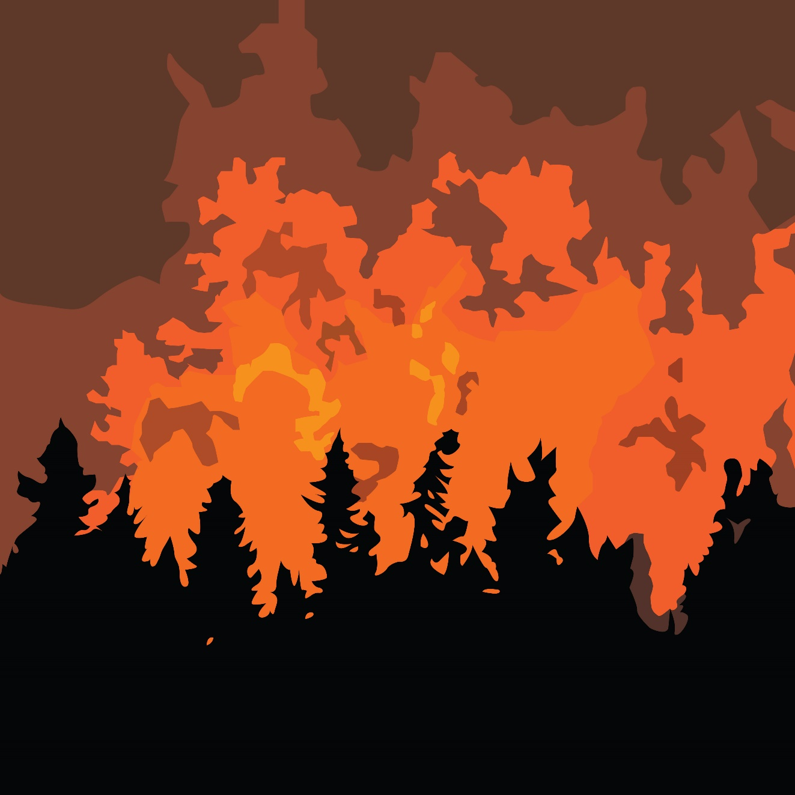
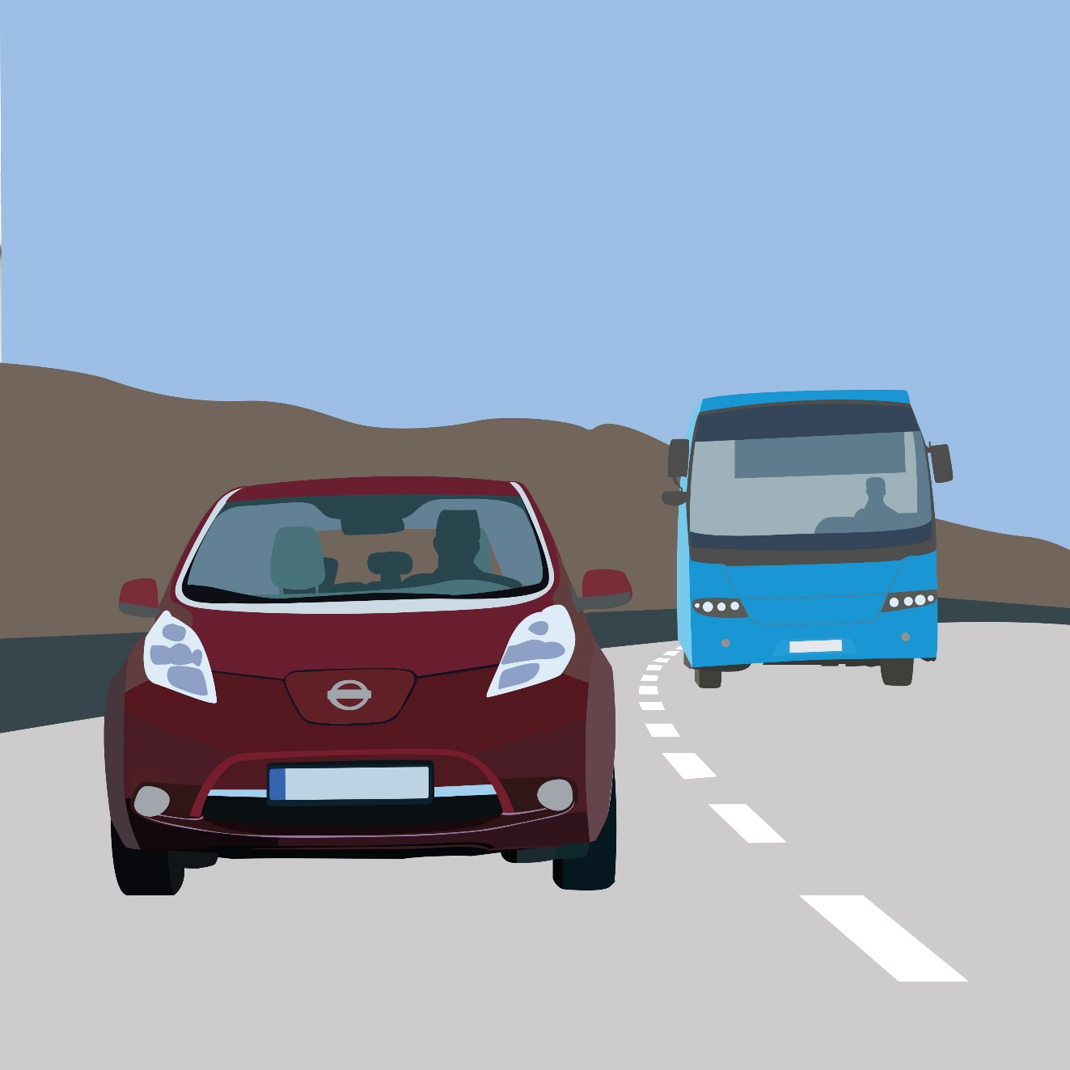


Slide 4


Lifetime
Atmospheric mixing
(Meteorology)
After 10 days [NH₃] – 50%
After 10 days [CO] – 15%

Slide 5
Australian fires, january 2020

Slide 6
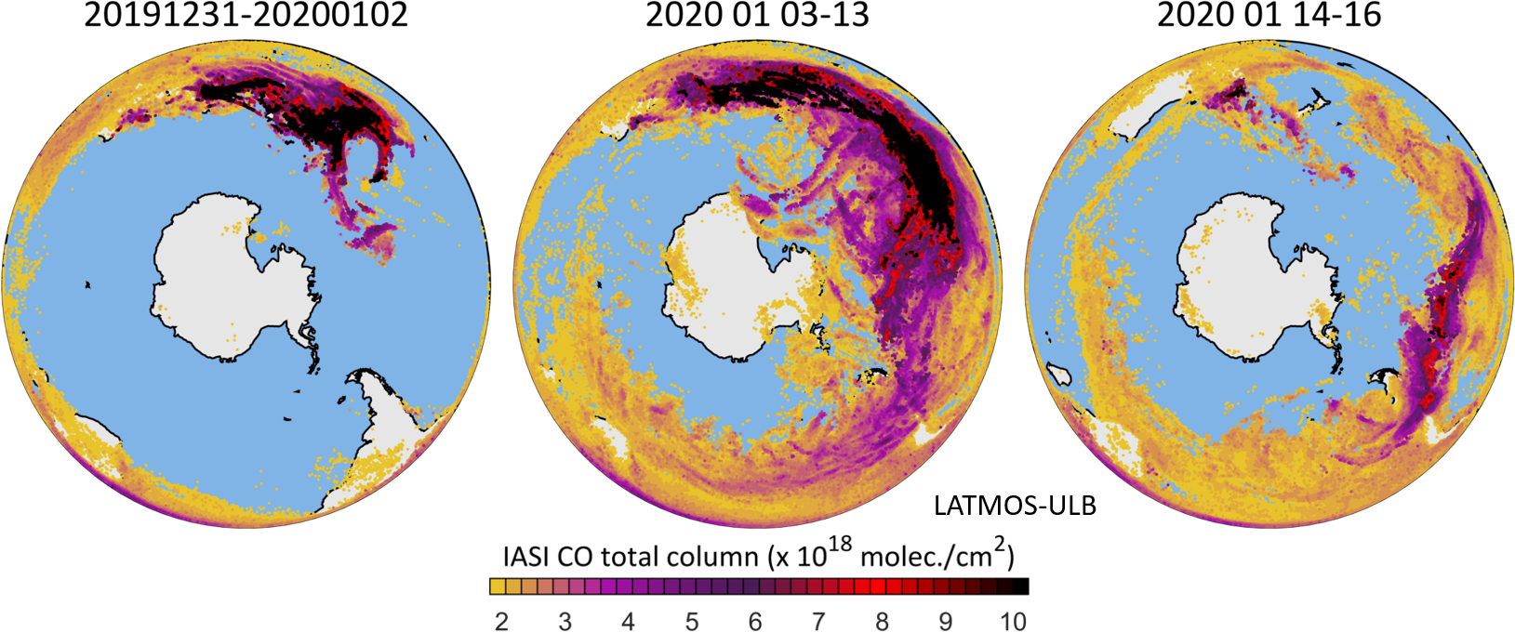
Credit Maya George (LATMOS)

Slide 7
China lockdown,
February 2020

Slide 8
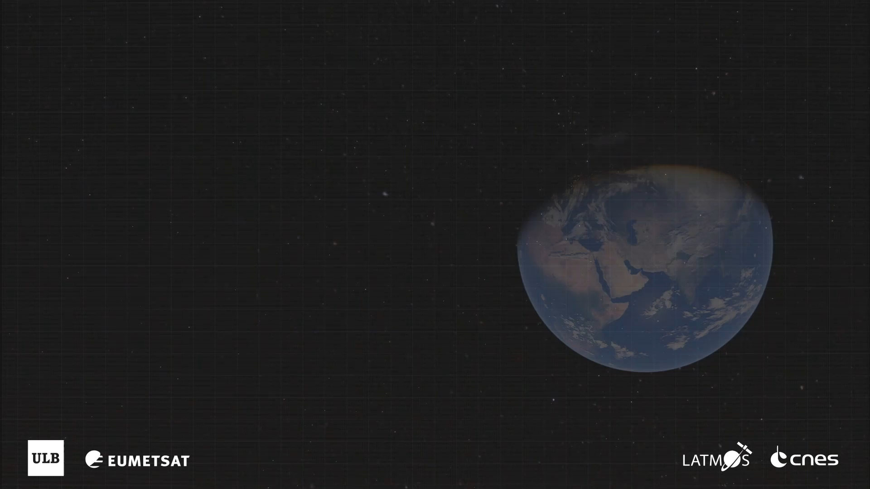

Slide 9

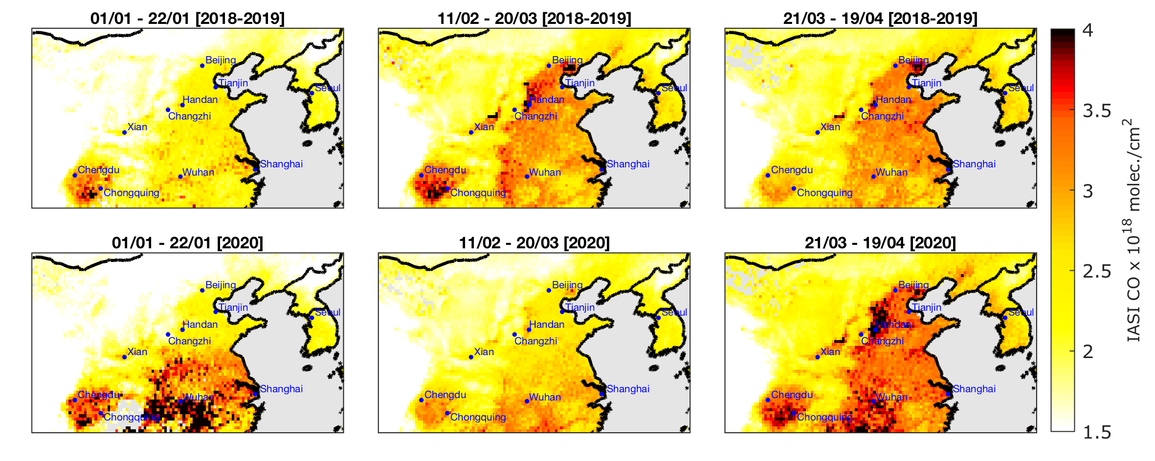
CO – China before-during-after lockdown
Credit Anne Boynard (LATMOS)

Slide 10
Paris lockdown,
March 2020

Slide 11
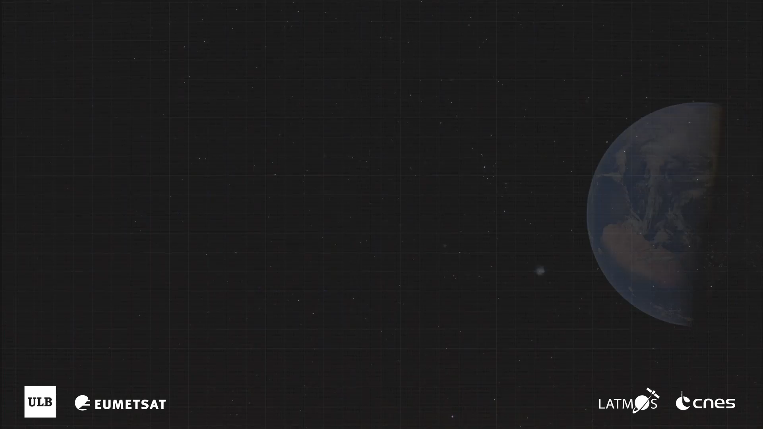

Slide 12
Californian fires,
September 2020

Slide 13
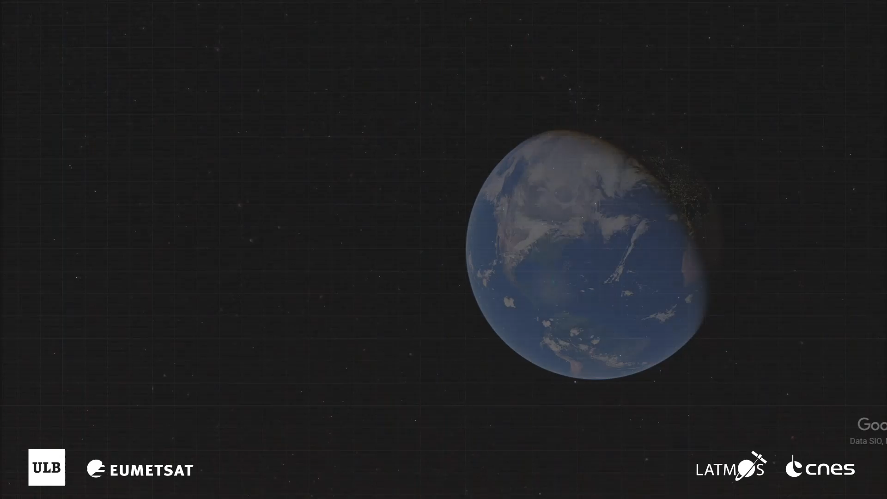

Slide 14
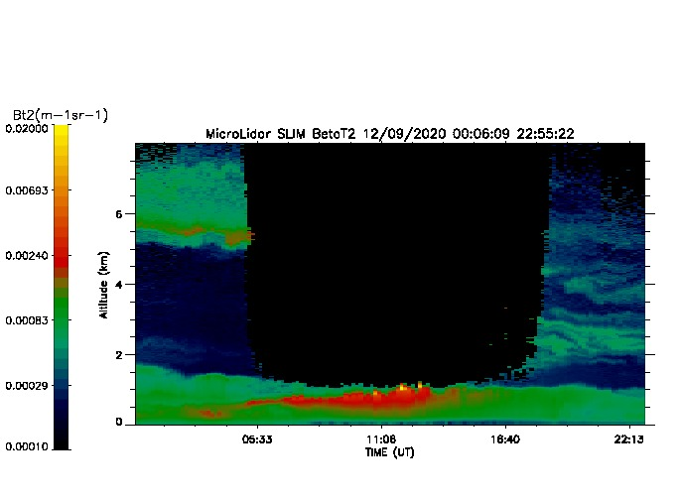
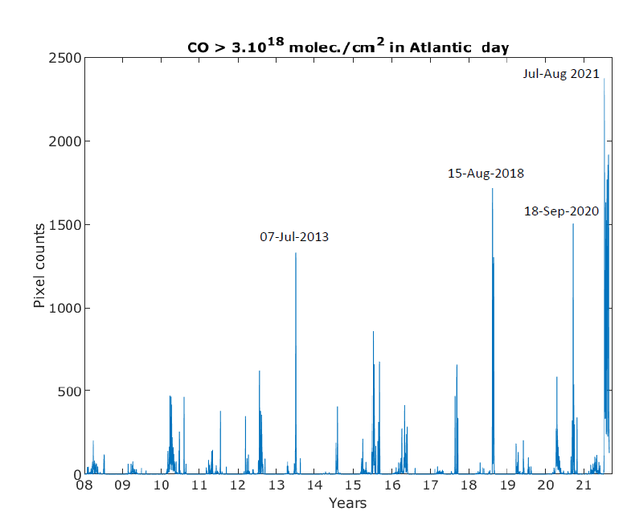
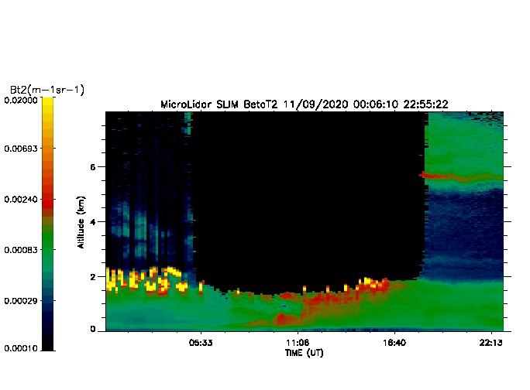
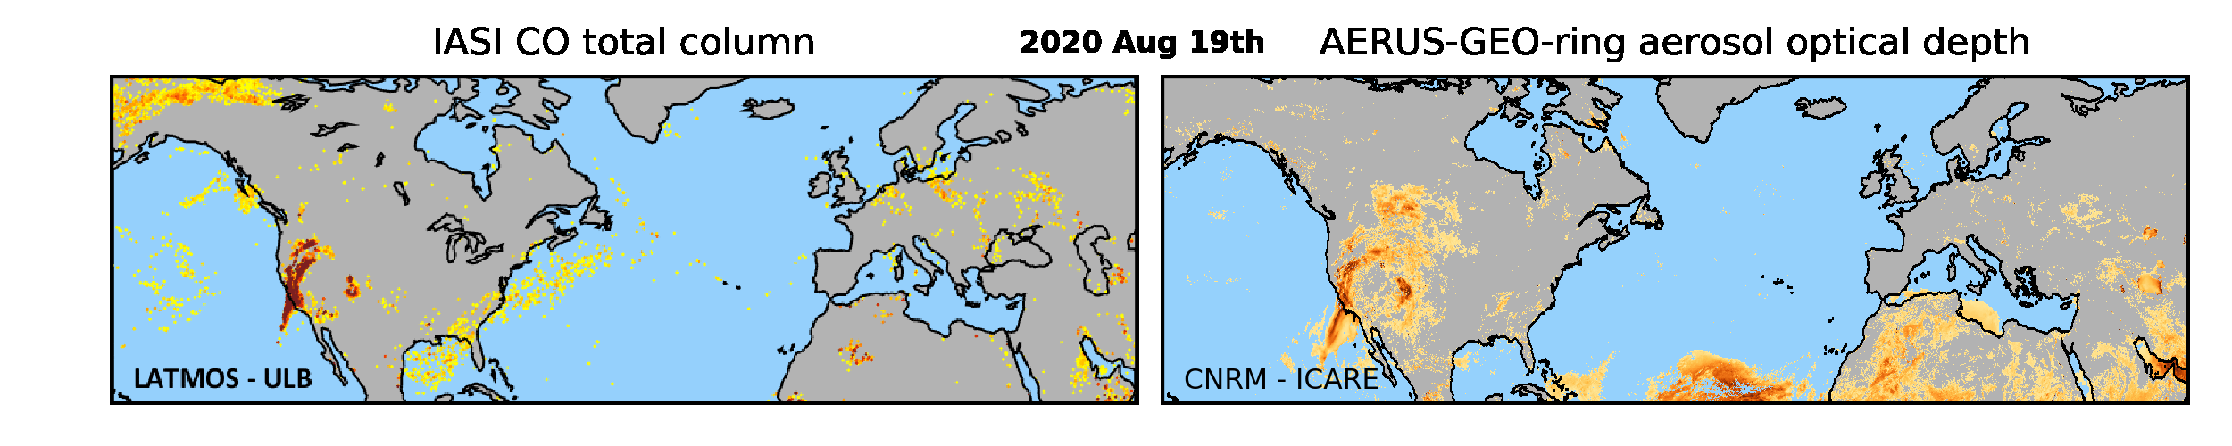
plume seen by lidar SLIM?
2020 09 12
2020 09 11
Credit M. George
Credit Camille Viatte
Credit Xavier Ceamanos

Slide 15
